Slide 1
NODE.JS
(The Backend Of MERN Stack)
Lecture 8

Slide 2
Today’s Agenda
Promise and fs Module
Using promises object
Checking file access
Granting file permissions
Writing to file
Reading from file

Slide 3
Promise and fs module
As mentioned earlier, when the fs module was first created, the primary way to write asynchronous code in Node.js was through callbacks.
As promises grew in popularity, the Node.js team worked to support them in the fs module out of the box.
So, they created a promises object in the fs module that uses promise, while the main fs module continues to expose functions that use callbacks.

Slide 4
How to use fs/promises ?
Following are the steps to be followed to use promise based methods from fs/promises:
Import the fs/promises object
Call the desired function of promises object and receive the return value as a promise.
Use then and catch to handle resolved and rejected state of the returned promise.

Slide 5
How to import fs/promises ?
We can import the promises object from fs module in 2 ways:
Node.js v10.0.0: used as require('fs').promises
Node.js v14.0.0: also available as require('fs/promises')

Slide 6
Important functions of fs/promises
The fs/promises API provides the following methods:
access()
writeFile()
appendFile()
readFile()
unlink()
mkdir()
readdir()
chmod()
and many more

Slide 7
The fsPromises.access() method
Syntax:
fsPromises.access( path, mode)
path: It is a String, Buffer or URL that denotes the path of the file or directory for which the permission has to be tested.
mode: It is an integer value that denotes the permission to be tested for. It can have the values fs.constants.F_OK, fs.constants.R_OK, fs.constants.W_OK and fs.constants.X_OK. Its default value is fs.constants.F_OK.
Return value: Returns a Promise object with:
undefined if resolved
error object if rejected

Slide 8
Exercise 21
WAS to check whether a file called message.txt is present in the text_files folder of your app .
If it is present then print the message File exists otherwise print the message File does not exists

Slide 9
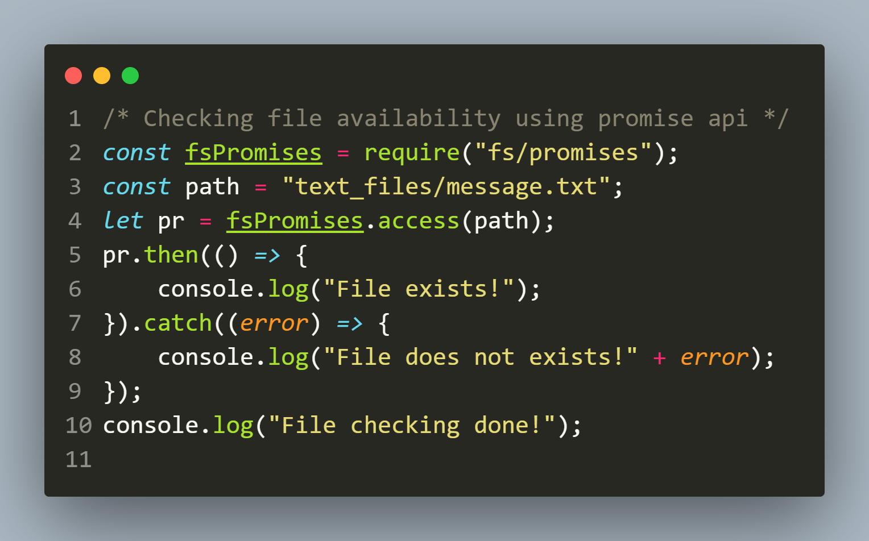
Solution

Slide 10
Using async/await with promise
Although the previous code works well but it might be hard to read and understand specially because it uses a feature called promise chaining.
So Node supports async/await syntax also which was introduced in ES8.

Slide 11
Using async/await with promise
The async keyword is applied before a function definition and makes that function an async function while the await keyword is permitted within the function body.
The async and await keywords enable asynchronous, promise-based behavior to be written in a cleaner style, avoiding the need to explicitly configure promise chains.

Slide 12
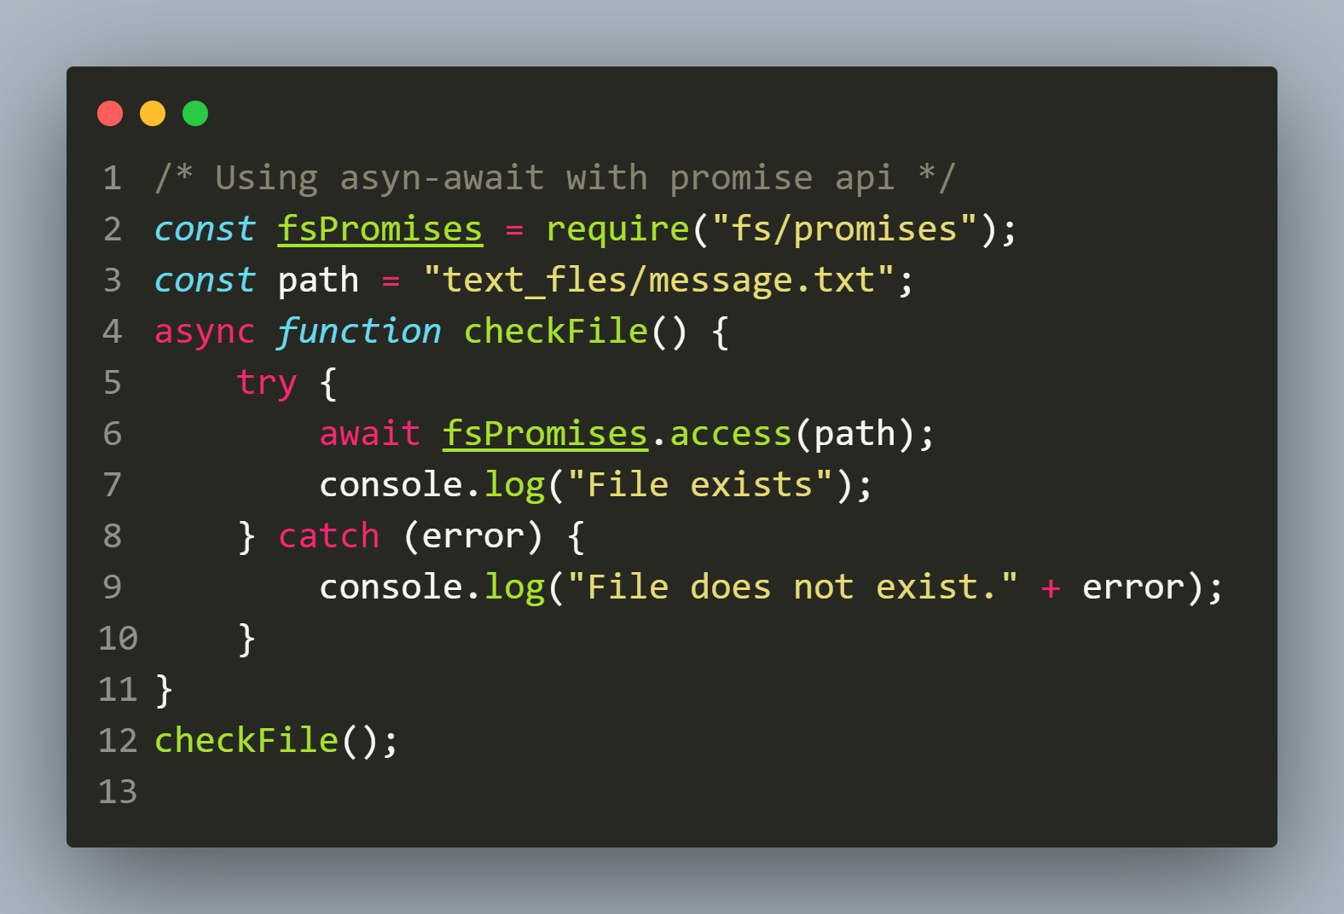
Another Solution

Slide 13
The fsPromises.chmod() method
The fsPromises.chmod() method is used to change the permissions of a given path.
These permissions can be specified using string constants or octal numbers that correspond to their respective file modes.
Syntax:
fsPromises.chmod(path, mode)

Slide 14
The fsPromises.chmod() method
Syntax:
fsPromises.chmod(path, mode)
path: It is a String, Buffer or URL that denotes the path of the file or directory for which the permission has to be tested.
mode: It is an integer value that denotes the permission to be granted. It can have the values as shown in the next slide
Return value: Returns a Promise object with:
undefined if resolved
error object if rejected

Slide 15
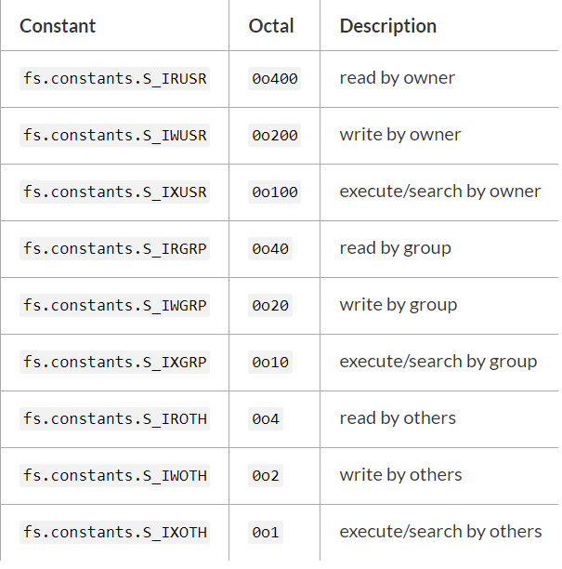
The fsPromises.chmod() method
Note: The Windows platform only supports the changing of the write permission. It also does not support the distinction between the permissions of user, group, or others.

Slide 16
Exercise 22
WAS to set the READ ONLY permission for the file message.txt which is present in the text_files folder of your app .
If permission is granted then print the message File set to Read Only mode otherwise print the message Error in setting permission

Slide 17
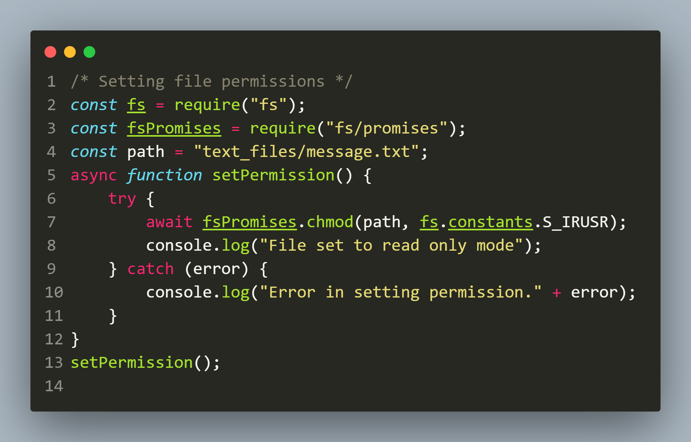
Solution

Slide 18
Exercise 23
Modify the previous script so that now:
Your code first checks whether the file is PRESENT and WRITING permission is set or not.
If Yes , then set the permission to READ ONLY.
Finally again check whether WRITING permission is on

Slide 19
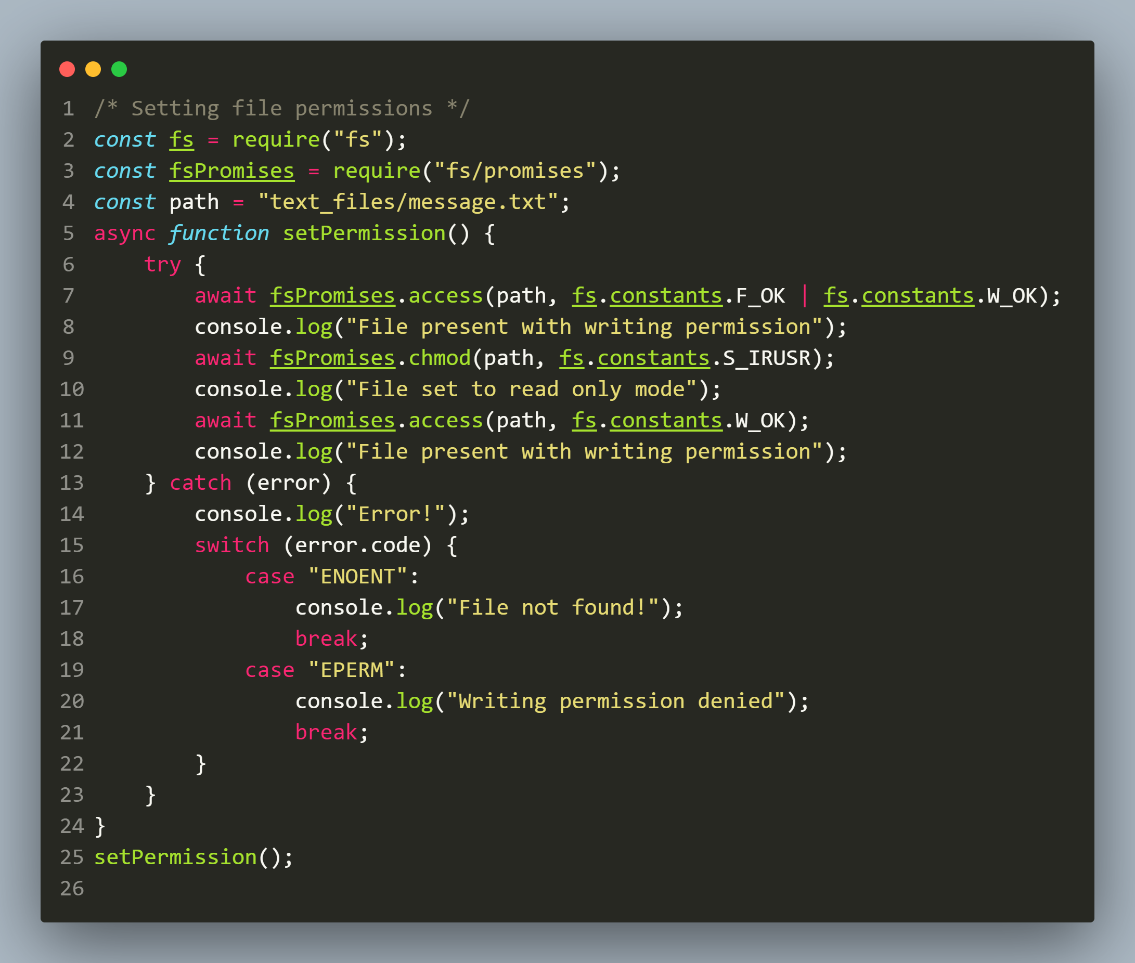
Solution

Slide 20
The fsPromises.writeFile() method
The fsPromises.writeFile() method is used to asynchronously write the specified data to a file.
By default, the file would be replaced if it exists, however the ‘options’ parameter can be used to modify the functionality of the method.
Syntax:
fsPromises.writeFile(path, data,options)

Slide 21
The fsPromises.writeFile() method
Syntax:
fsPromises.writeFile(path, data, options)
path: It is a String, Buffer or URL that denotes the path of the file or directory in which writing is to be done. If the file is not present it gets created and if it is present it gets overwritten
data: It is a String, Buffer or Object that needs to be written into the file
options: It is an string or object that can be used to specify optional parameters that will affect the output. It contains encoding, mode and flag values
Return value: Returns a Promise object with:
undefined if resolved
error object if rejected

Slide 22
Exercise 24
WAS to create a file called message.txt in the text_files folder of your app .
Now write the message Welcome to Node.js in the file and at the end also write the current date and time in the file in locale specific format.

Slide 23
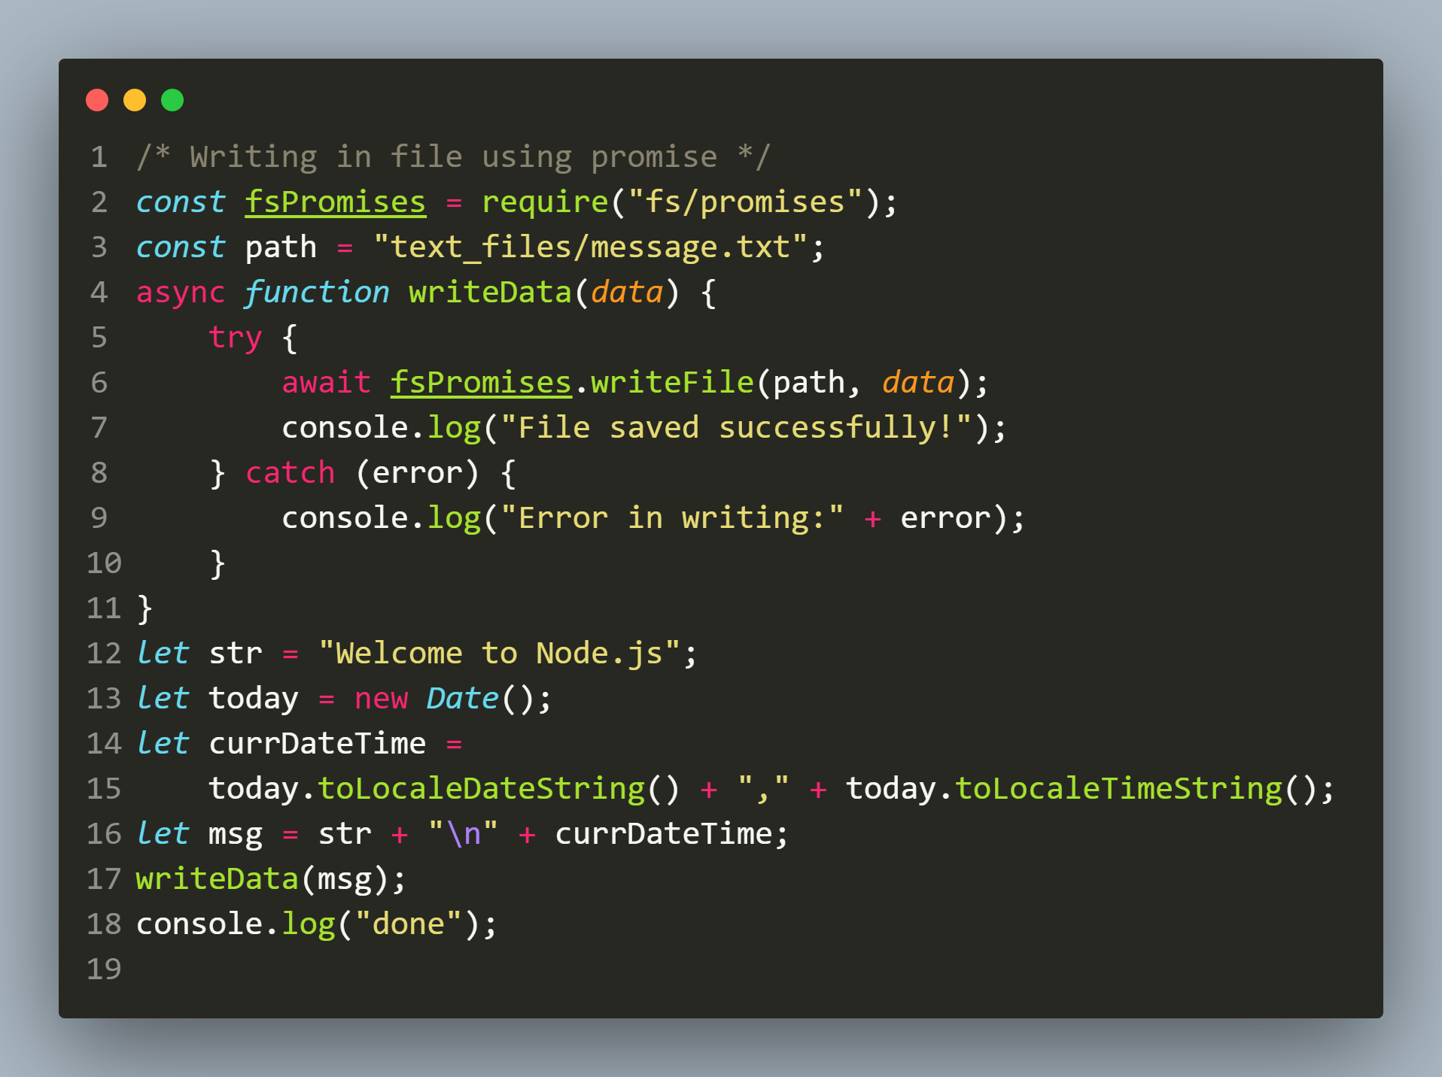
Solution

Slide 24
The fsPromises.readFile() method
The fsPromises.readFile() method is used to asynchronously read the data from the specified file.
It takes two arguments: the file path and the options indicating the encoding and returns a Promise on completion
Syntax:
fsPromises.readFile(path, options)

Slide 25
The fsPromises.readFile() method
Syntax:
fsPromises.readFile(path,options)
path: It is a String, Buffer or URL that denotes the path of the file or directory in which writing is to be done. If the file is not present it gets created and if it is present it gets overwritten
options: It is an string or object that can be used to specify optional parameters that will affect the output. It contains encoding, mode and flag values
Return value: Returns a Promise object with:
File data if resolved
error object if rejected

Slide 26
Exercise 25
WAS to open a file called message.txt in the text_files folder of your app .
Now read the contents of the file and display it in console.
If the file is not present then display the message File not found and for any other error handle it by displaying actual error message

Slide 27
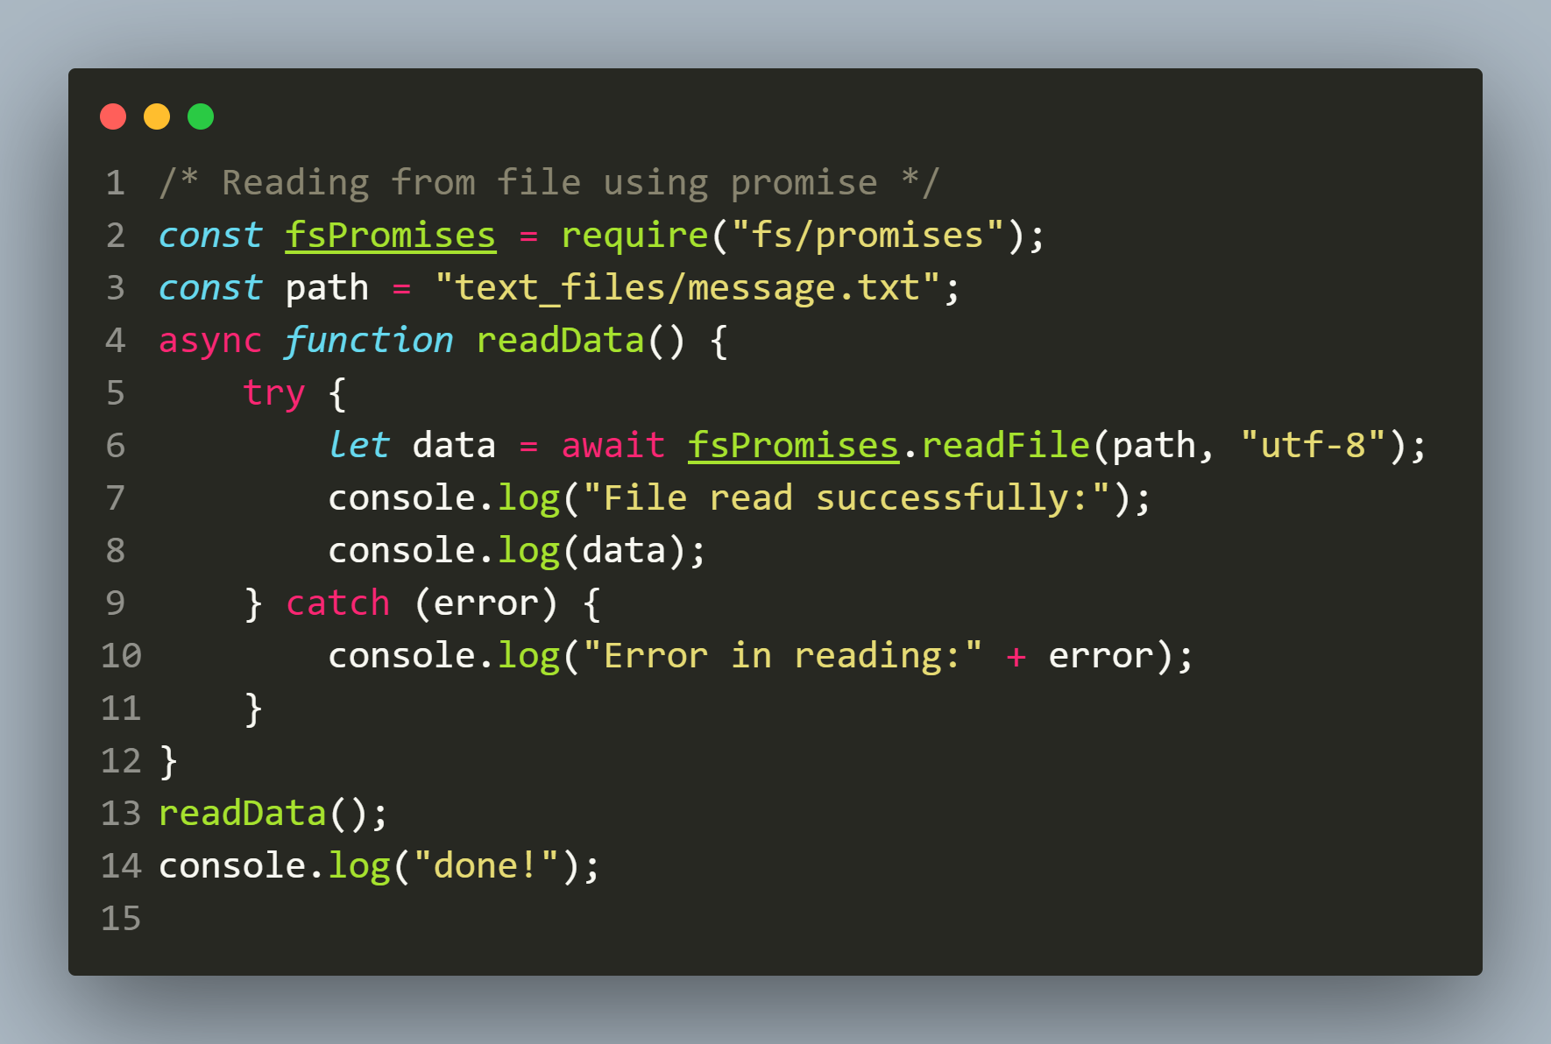
Solution

